Slide 1
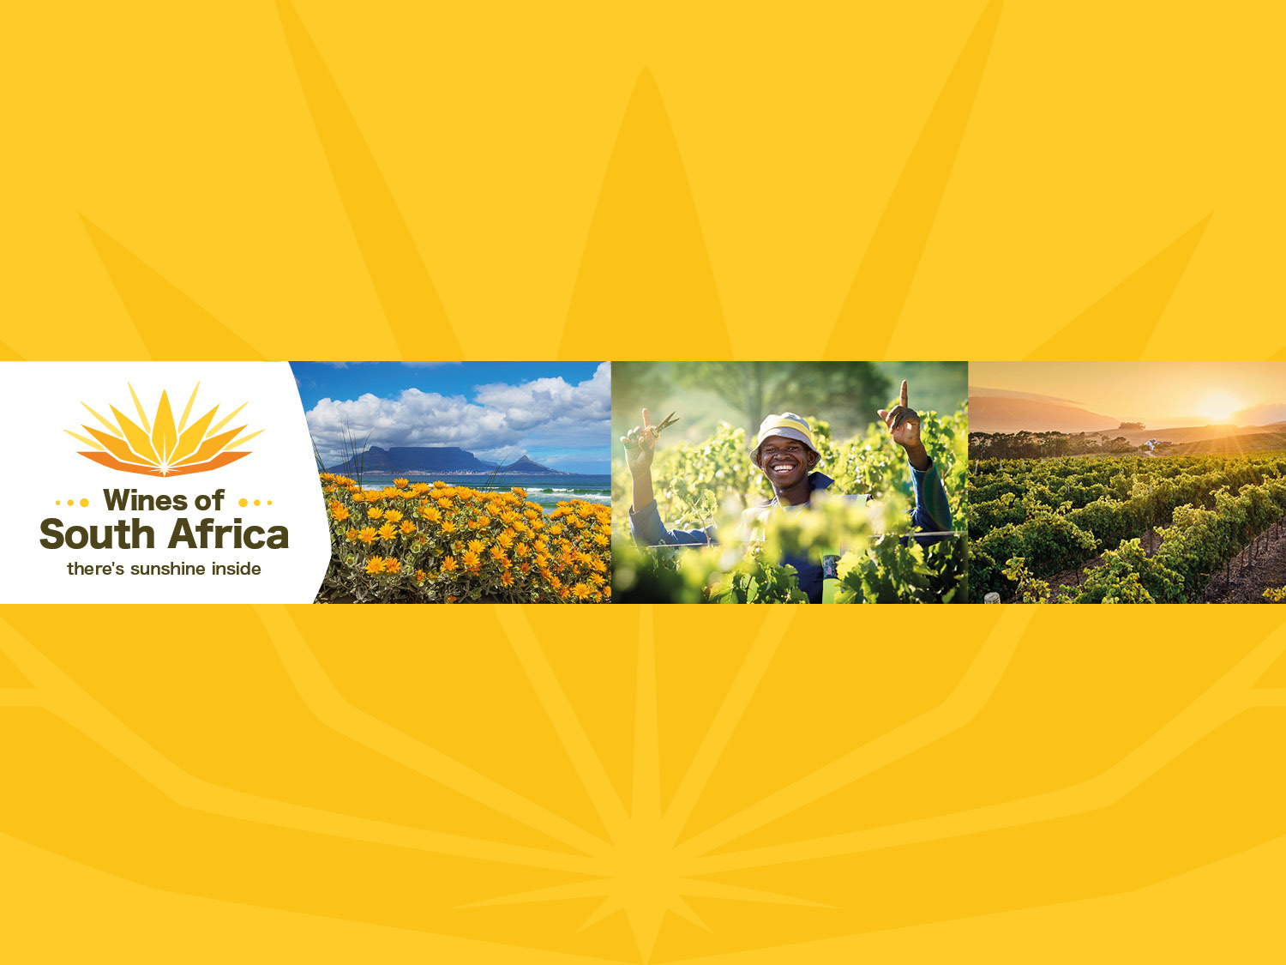
Welcome
Notes:
Wines of South Africa

Slide 2
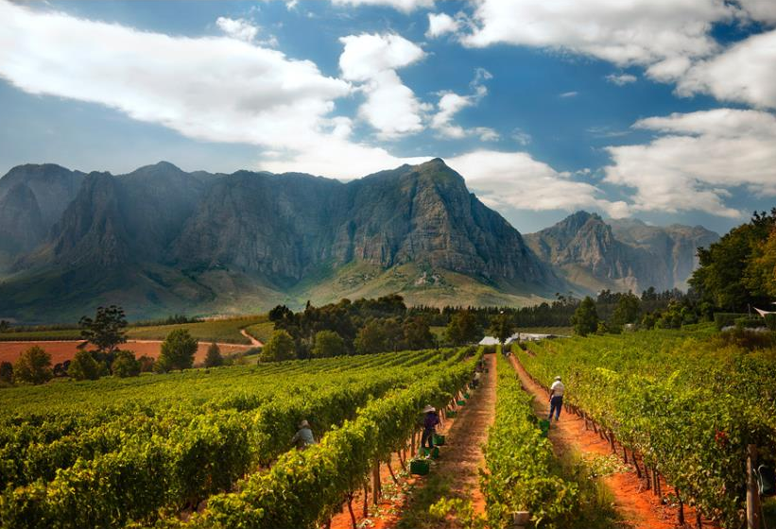
SOUTH AFRICA - an introduction
Notes:
An introduction

Slide 3
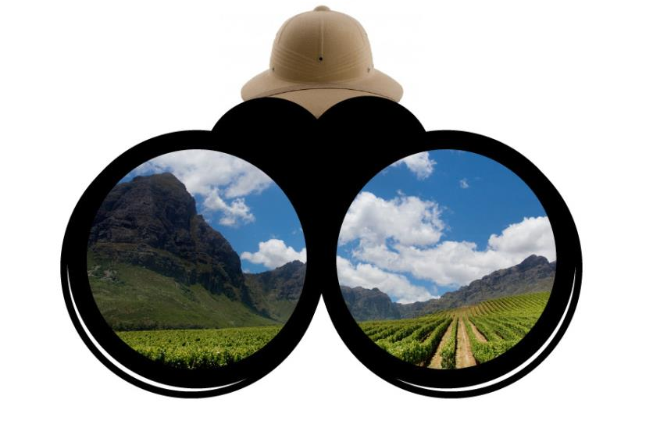
Where is SOUTH AFRICA?
Notes:
Where is South Africa?

Slide 4

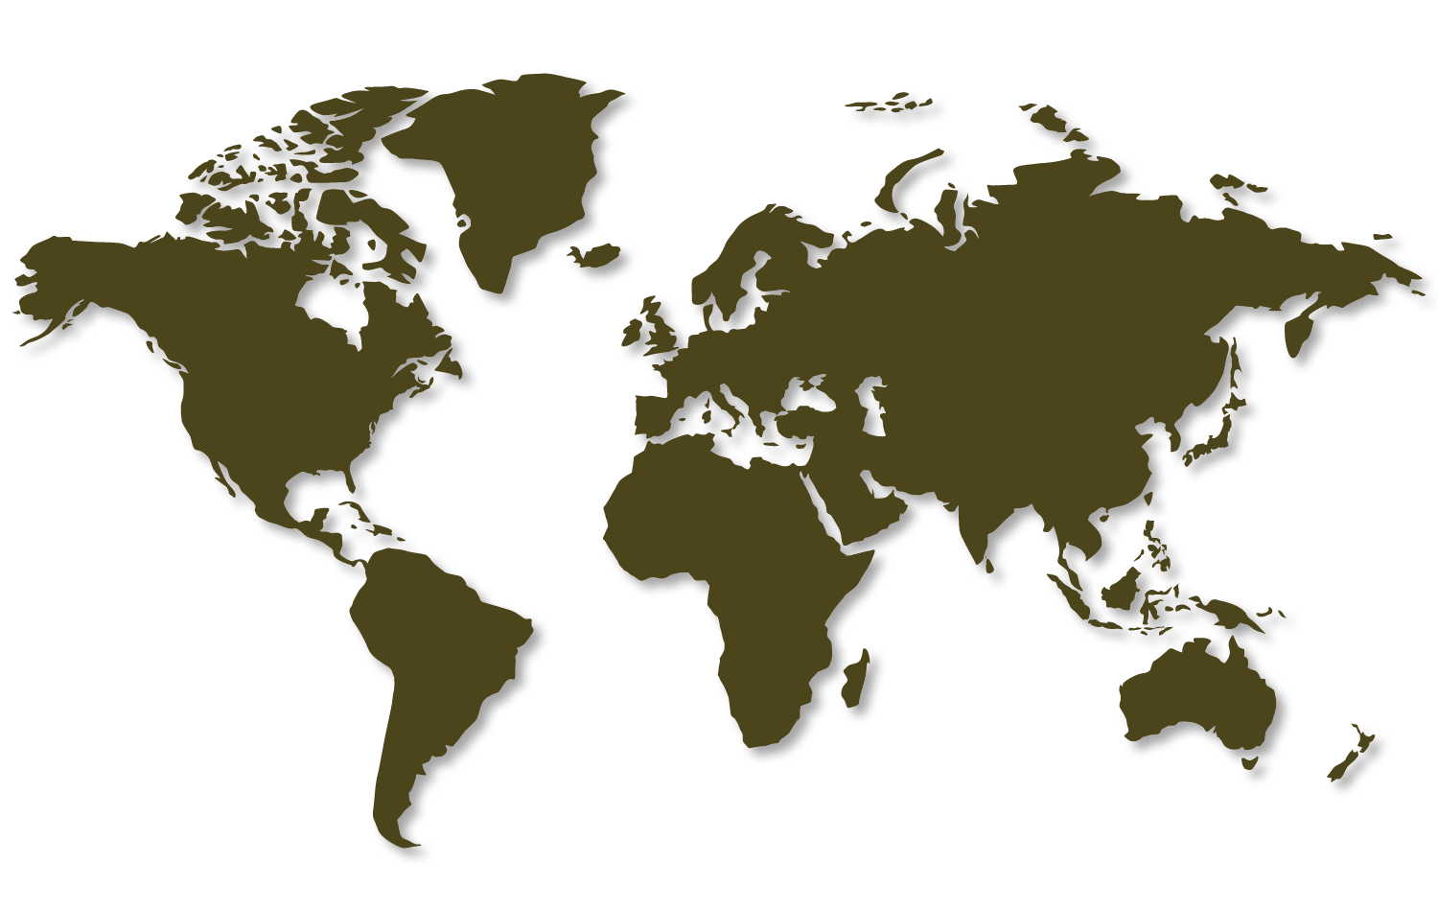
South Africa
Where in the world?
Notes:
South Africa is the southernmost country in Africa and our winelands are located at the very tip of South Africa.

Slide 5

Winegrowing areas of South Africa
Notes:
Cape Town is the gateway to our winelands with several diverse regions within close proximity.

Slide 6
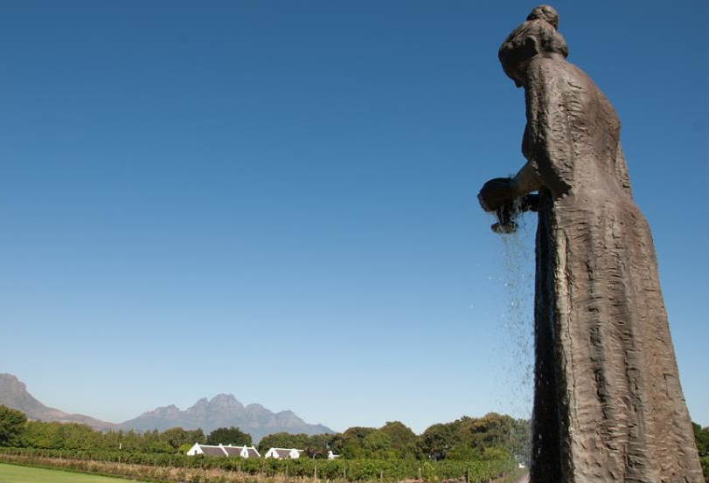
Looking back – our heritage
Notes:
Looking back…

Slide 7
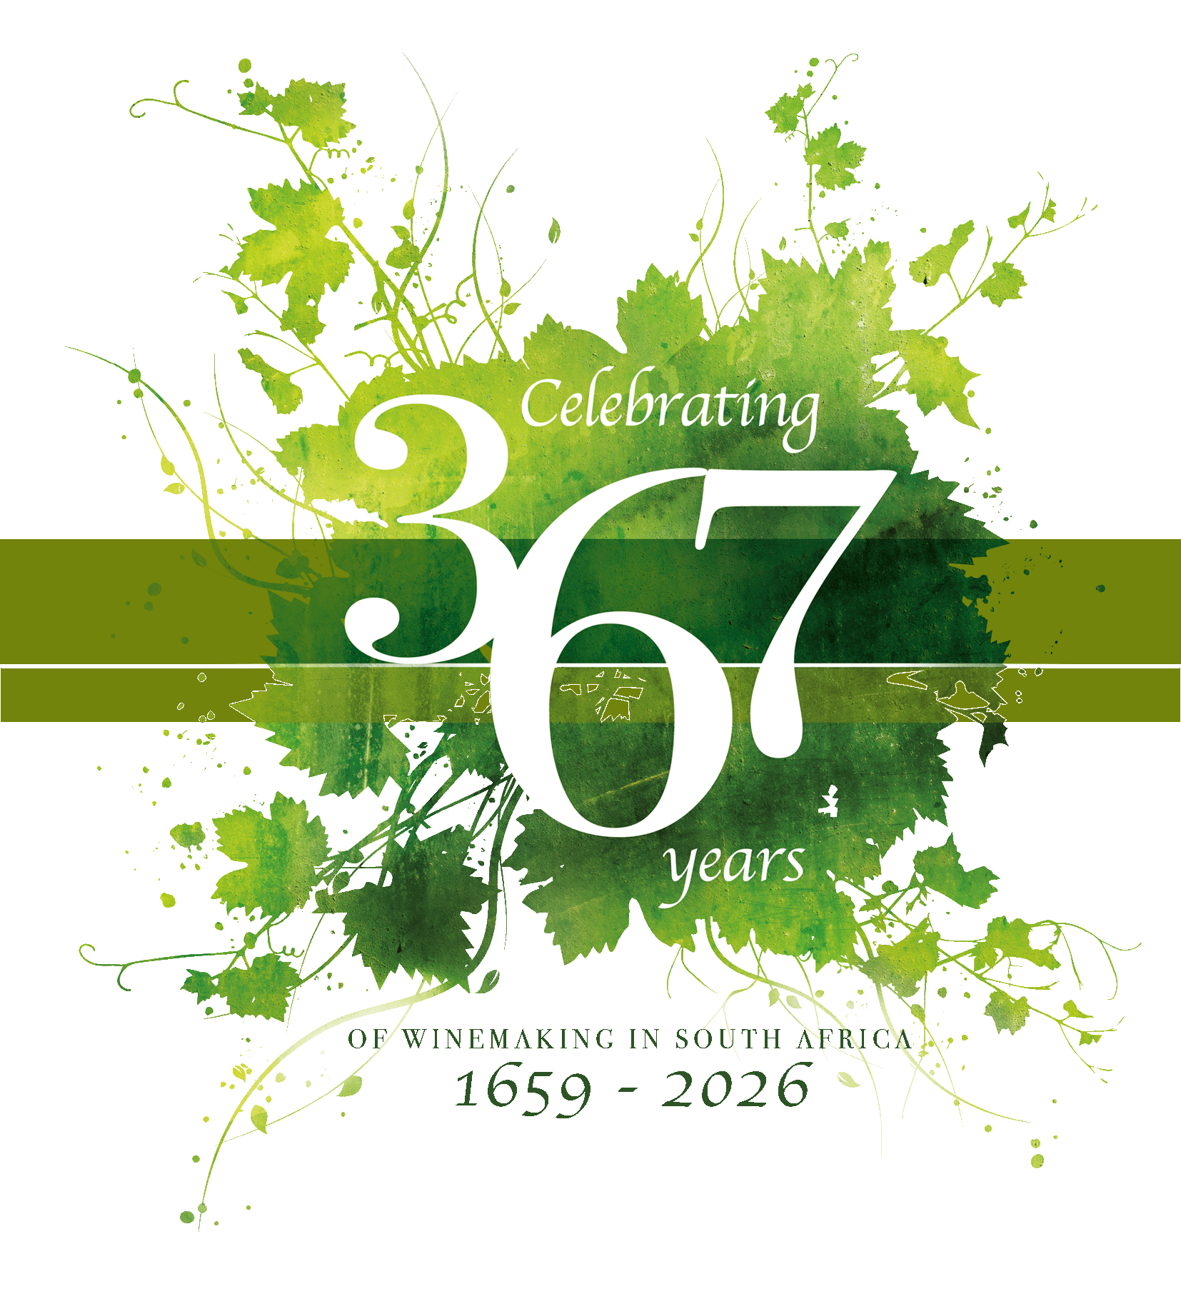
Notes:
South Africa has celebrated 367 years of winemaking.

Slide 8
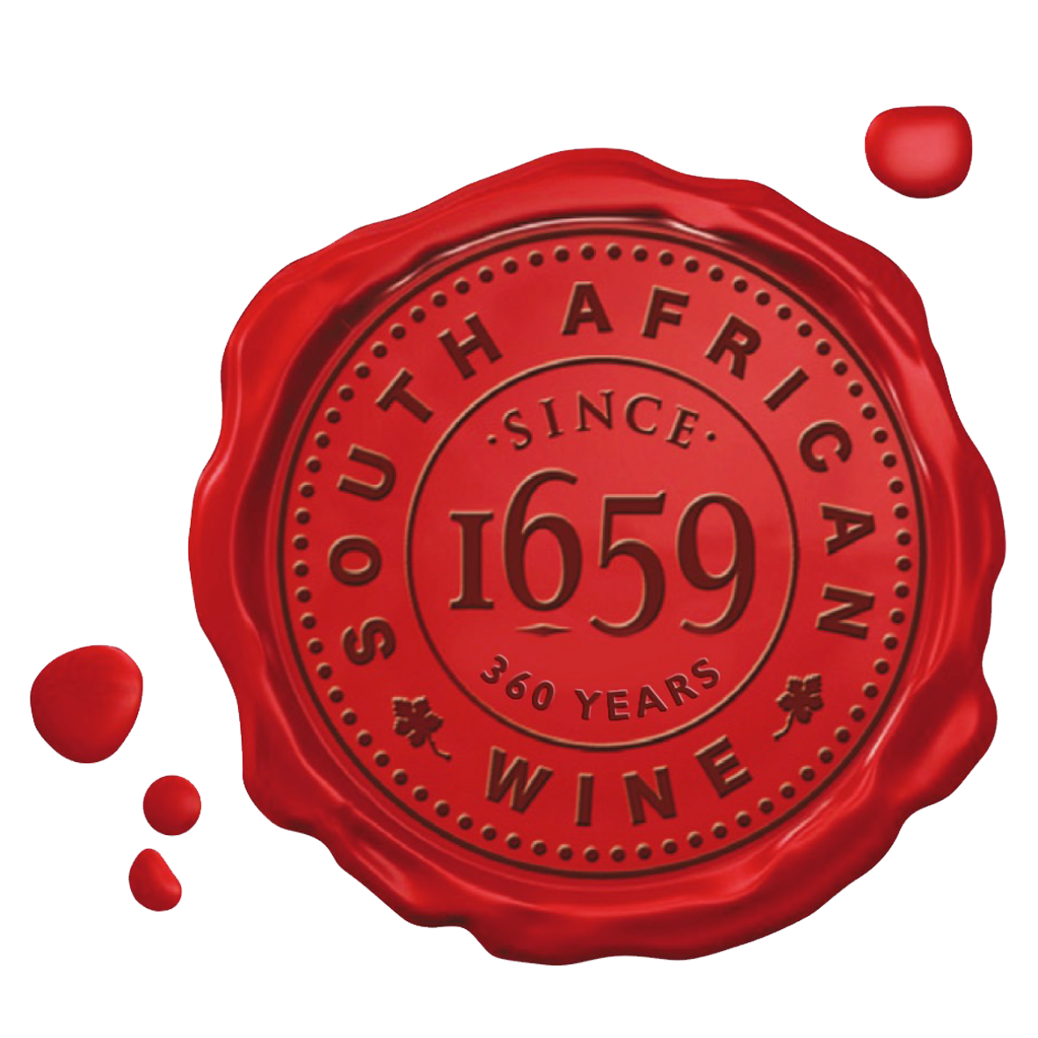
The beginning of winemaking excellence
Notes:
Winemaking dates back to 1659.

Slide 9
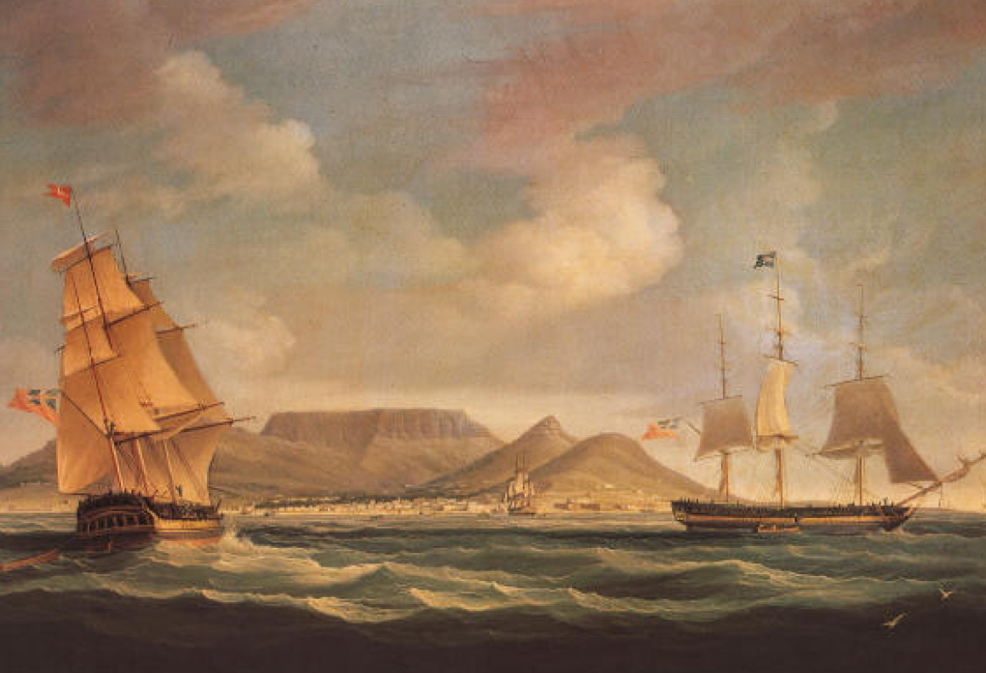
1652 – The Dutch East India Company
established a refreshment station to provide for the ships
en route to the spice trade in the East
Notes:
1652 – The Dutch East India Company established a refreshment station to provide for the ships en route to the spice trade in the East.

Slide 10
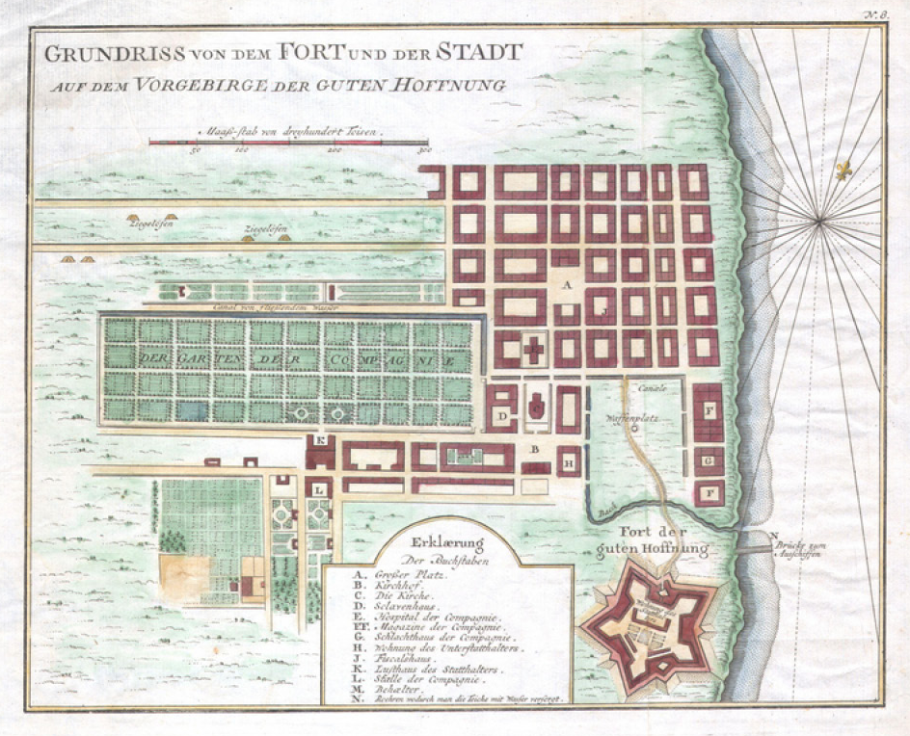
1655 – Governor Jan van Riebeeck
planted the first vines, imported from France, Spain and
the Rhineland, in the Company Gardens
Notes:
1655 – Governor Jan van Riebeeck planted the first vines, imported from France, Spain and the Rhineland, in the Company Gardens.

Slide 11
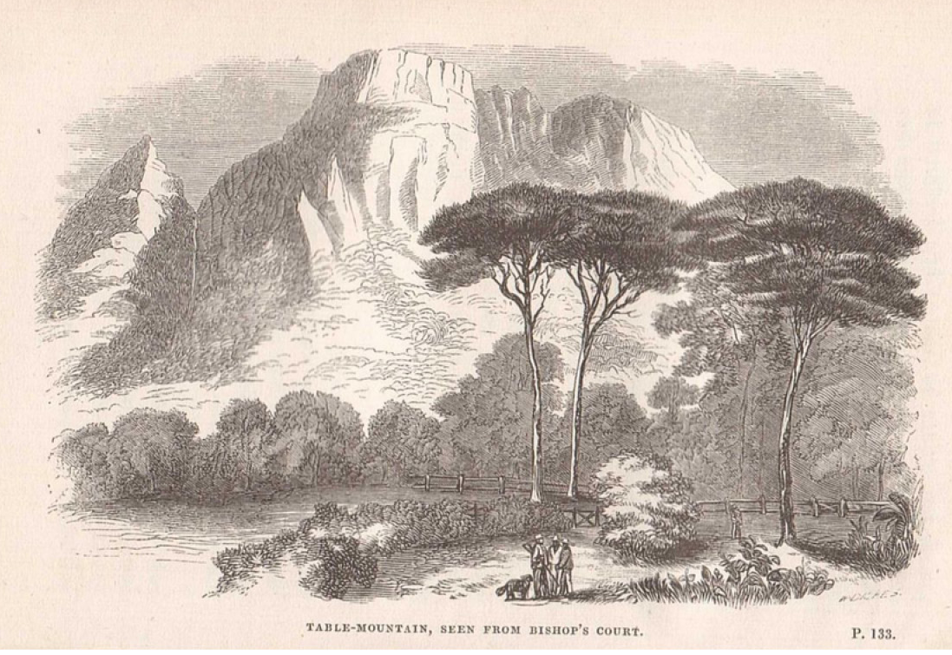
1658 – Van Riebeeck planted 1 000 vines
on his farm, Boscheuvel, in what is today Bishops Court
and Wynberg
Notes:
1658 – Van Riebeeck planted 1 000 vines on his farm, Boscheuvel, in what is today Bishops Court and Wynberg.

Slide 12
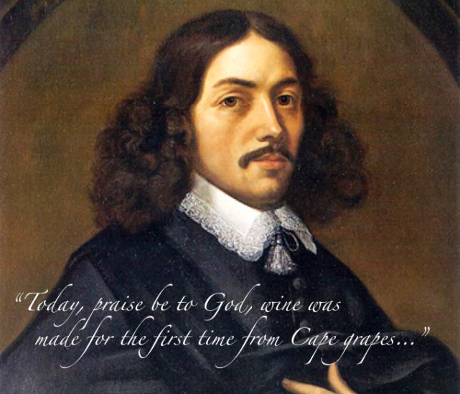
Jan Van Riebeeck’s famous diary entry
of 2 February 1659
Notes:
1659 – “Today , praise be to God, wine was made for the first time from Cape grapes...” Jan van Riebeeck’s famous diary entry on 2 February of that year. Out of all of the world’s wine-producing nations, South Africa is unique in knowing the exact date on which the wine industry began, thanks to this entry.

Slide 13
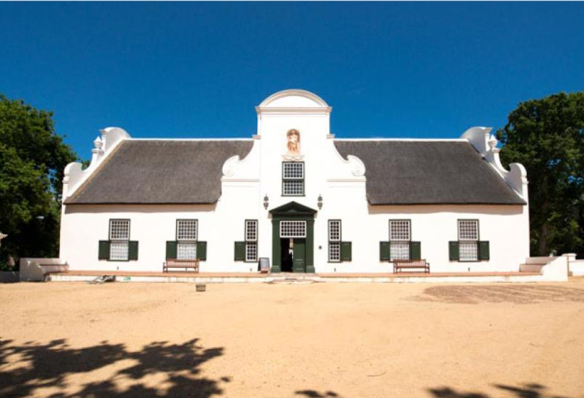
Groot Constantia
Notes:
Governor Simon van der Stel planted some 10 000 vines on the slopes of the Constantiaberg in 1685.
Today, centuries-old Cape Dutch homesteads are beautifully preserved on many of the Cape’s famous wine estates. Some good examples are:

Slide 14
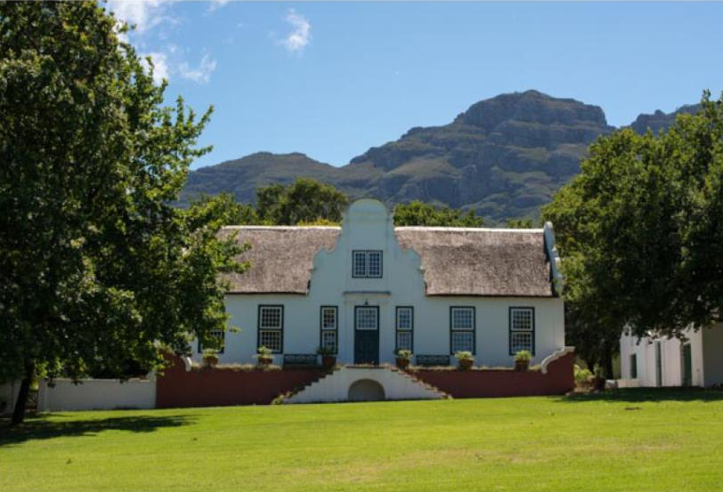
Rustenberg
Notes:
Rustenberg

Slide 15
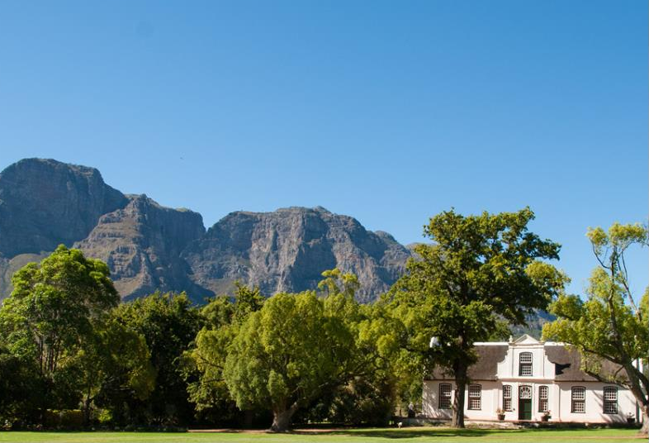
Boschendal
Notes:
Boschendal

Slide 16
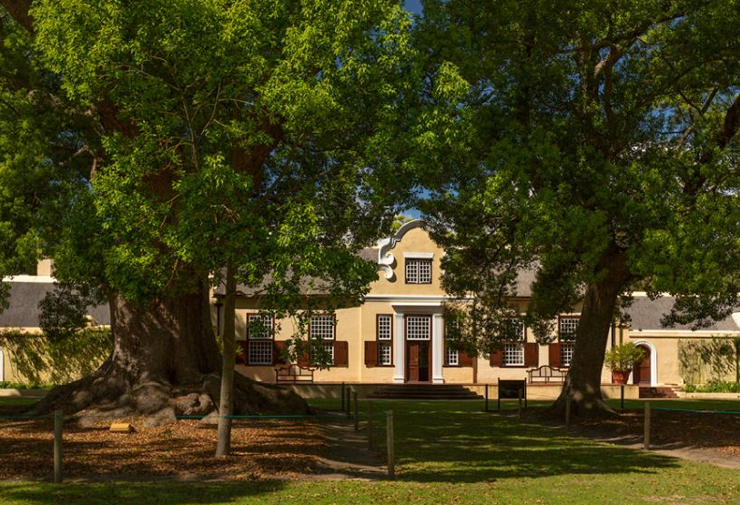
Vergelegen
Notes:
Vergelegen, with camphor trees that are more than 300 years old.

Slide 17
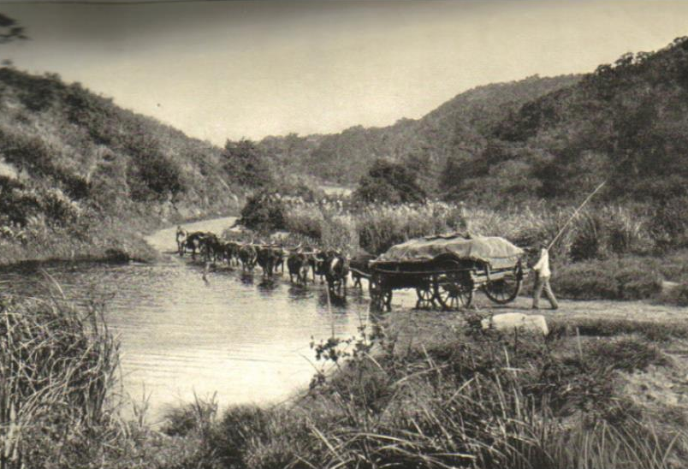
Wine transported for trading
Notes:
As trade grew, winegrowing spread into the countryside. Wine was transported from outlying areas by ox wagon.

Slide 18
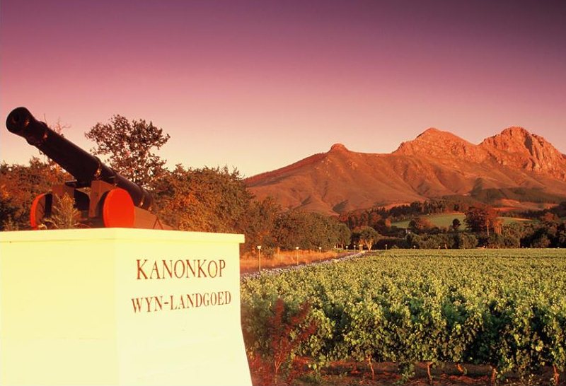
Kanonkop
Notes:
Canons were fired on the hilltops to alert farmers to the arrival of ships in Table Bay. Kanonkop, the name of a famous Stellenbosch wine estate, means Cannon Hill.

Slide 19
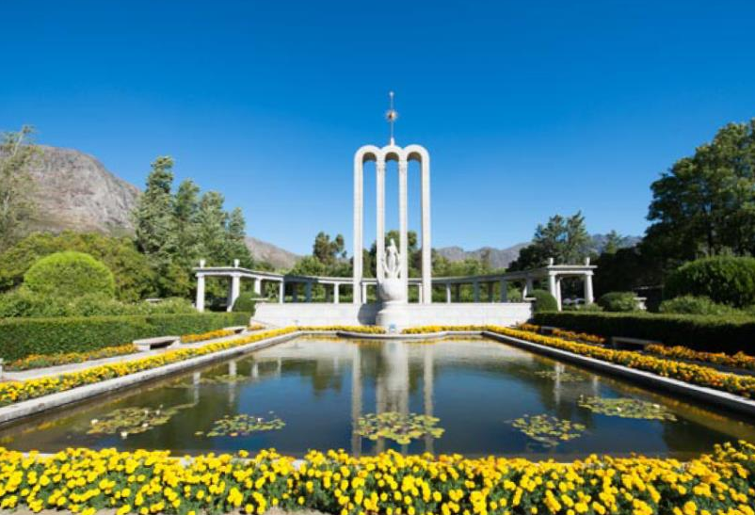
1688 – French Huguenots
Notes:
1688 – Fleeing religious persecution in France, a group of 150 Huguenots arrived, settling in the Drakenstein Valley, which subsequently became known as Fransche Hoek (later Franschhoek).

Slide 20
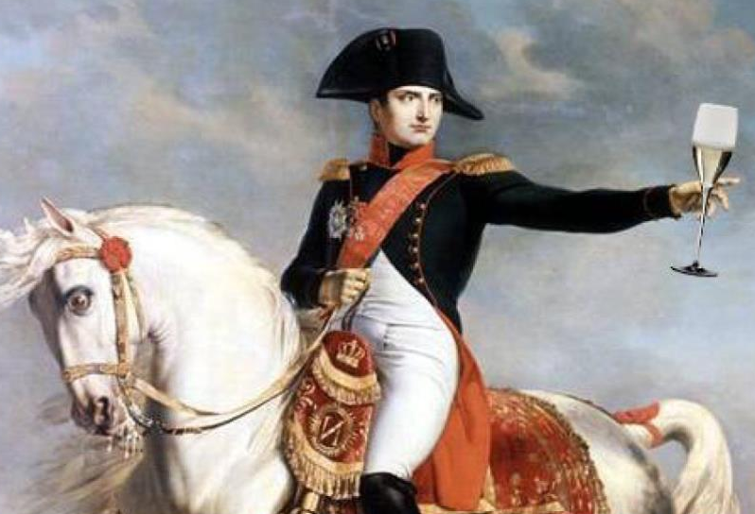
Mid-1700s – Our wine was famous
in the courts of Europe
Notes:
In the 18th century, wines from Constantia were exported to Europe, and earned great acclaim for their sweet and luscious nature. Both Baudelaire and Jane Austen mentioned Constantia wines in their writing.

Slide 21
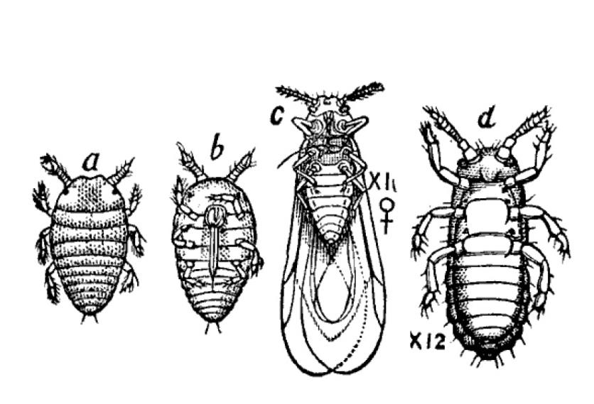
1886 – Phylloxera
Notes:
1886 – Phylloxera was discovered on vines on the banks of the Liesbeek River in Mowbray for the first time. The disease spread rapidly and resulted in the uprooting and destruction of millions of vines throughout the Cape.

Slide 22
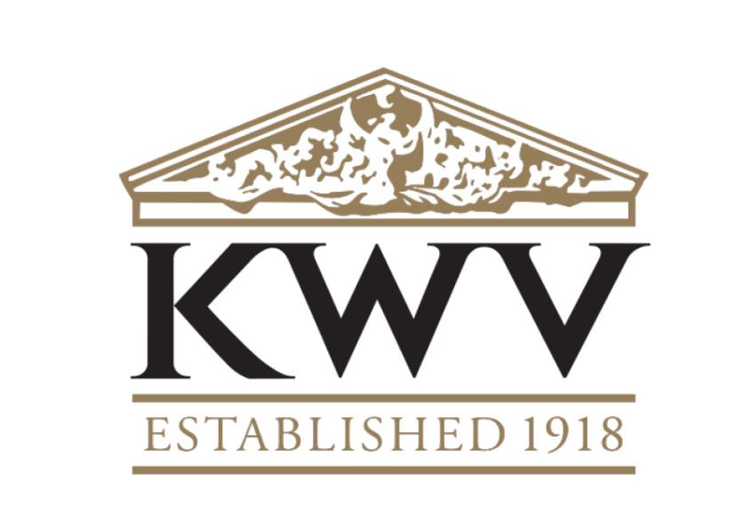
1918 – KWV
Notes:
1918 – The Ko-operatiewe Wijnbouwers Vereeniging van Zuid-Afrika Beperkt (KWV) was formed under the leadership of Charles WH Kohler, saving the industry from disaster through the control of volumes and production.

Slide 23
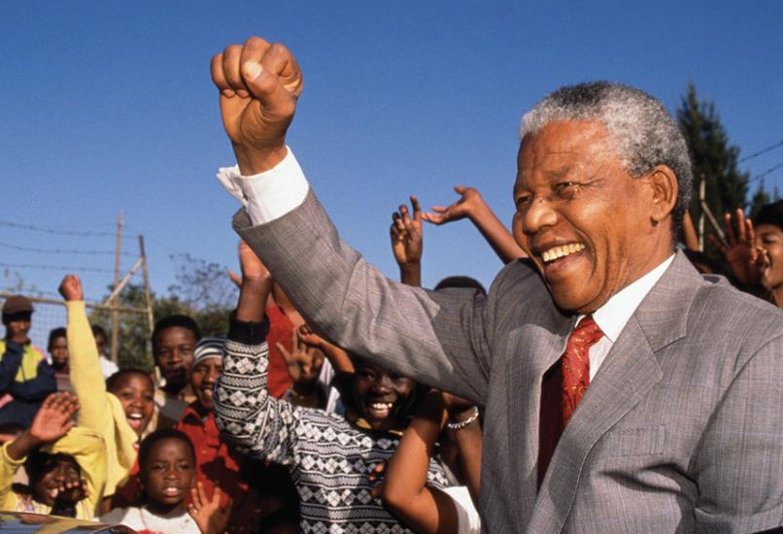
1990 – Nelson Mandela
Notes:
1990 – Nelson Mandela was released, paving the way for increased acceptability of South African wine abroad.

Slide 24
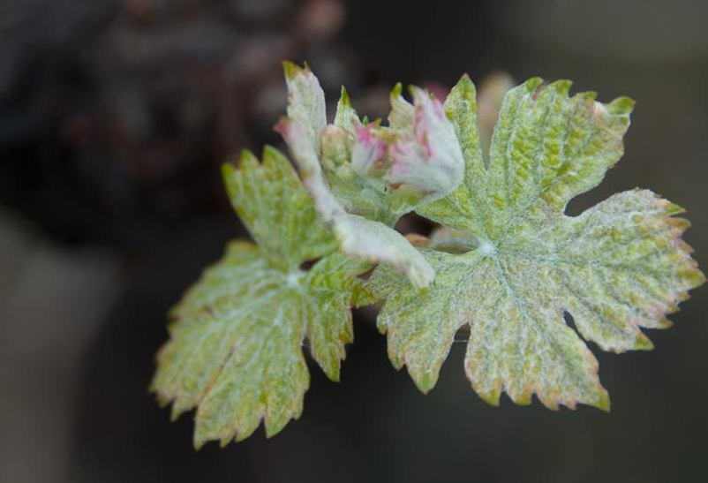
1994 – The birth of a modern wine industry
Notes:
1994 – South Africa became a democracy and the wine industry was also liberated. Wine exports started to take off, wine marketers and wine markets were exposed to international trends and know-how, and the farmers began replanting.

Slide 25
“South African wines
reflect the best of
the old and the new.”
Notes:
South African wines reflect the best of both the old and the new – presenting fruit-forward styles with elegance, finesse and restraint.

Slide 26
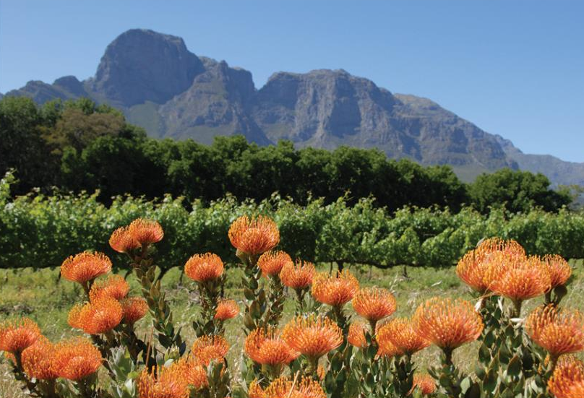
Our natural environment
Notes:
Our natural environment: Section 2

Slide 27
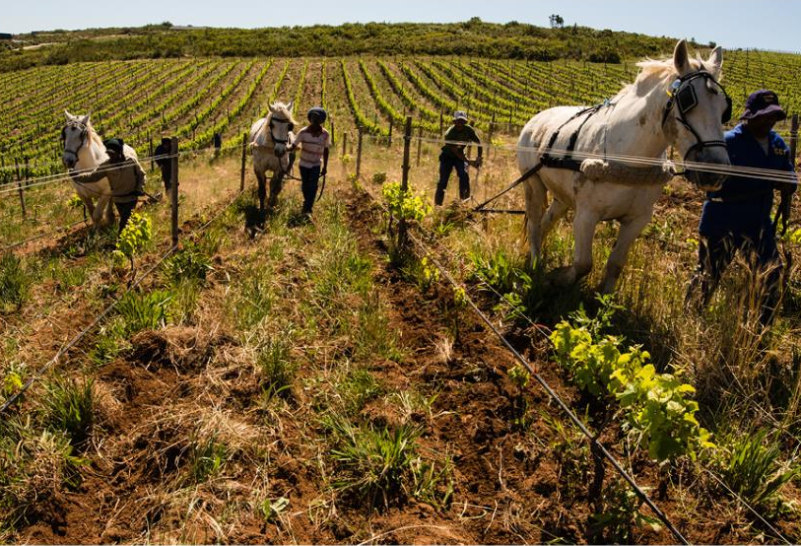
Oldest viticultural soils
Notes:
South Africa has the oldest viticultural soils in the world, dating back over 500 million years.

Slide 28
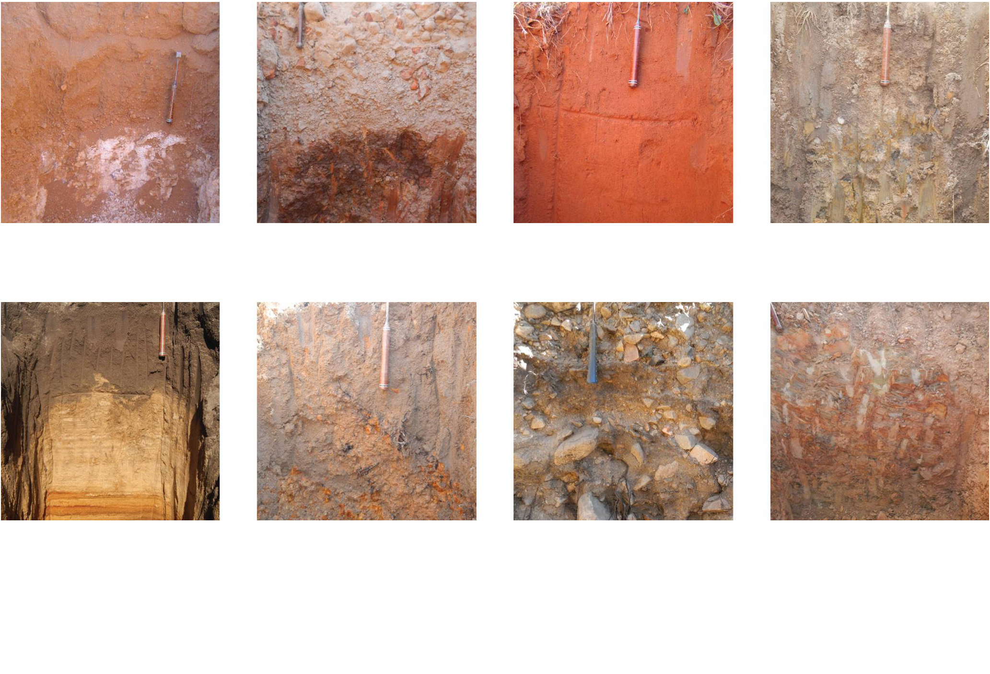
Calcic
Duplex
Oxidic
Gleycic
Podzolic
Plinthic
Cumulic
Lithic
Grouping of soil forms
Notes:
Soils vary greatly even within one hectare. The three most important soil groups are derived from shale, granite and sandstone.

Slide 29
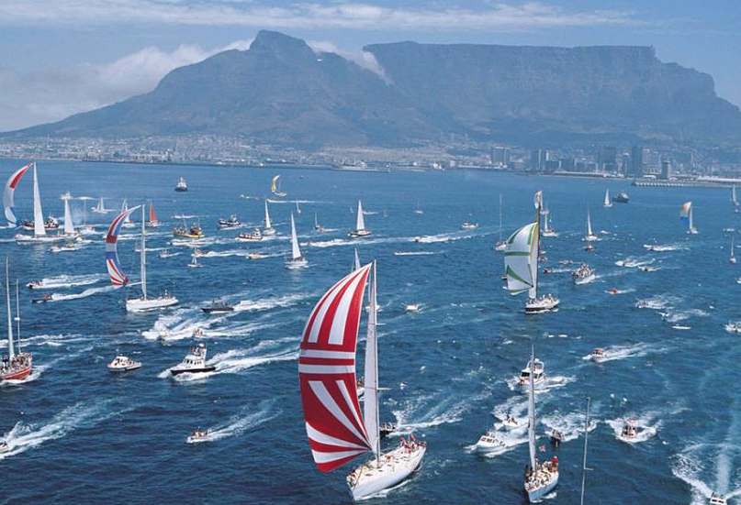
Two mighty oceans generate cooling fogs,
mists and winds
Notes:
The Cape winelands are surrounded by two mighty oceans that generate fogs, mists and winds, which cool the vineyards.

Slide 30
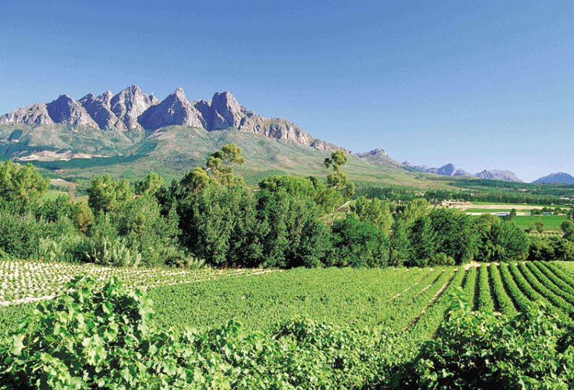
Steep mountain ranges
Notes:
The Cape winelands are crisscrossed by steep mountain ranges, giving each valley and wine region a different individual character.

Slide 31
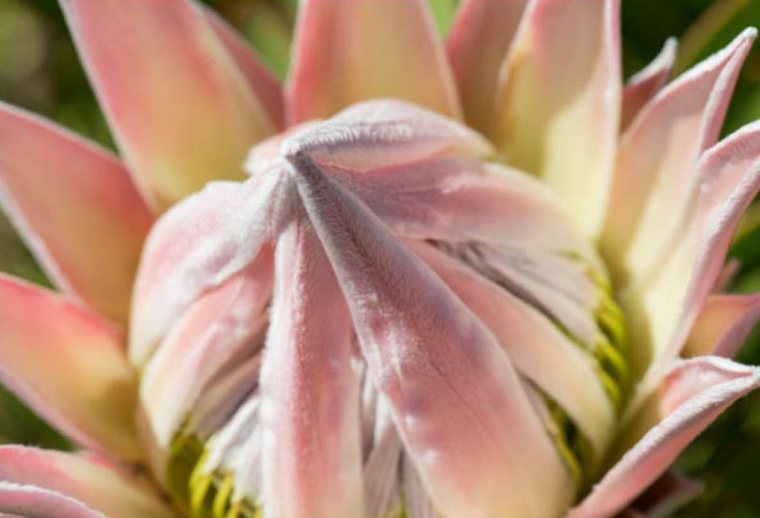
More than 9 600 endemic plant species of which
1 700 are threatened with extinction
Notes:
Over 95% of our wine is produced in the area known as the Cape Floral Kingdom. One of six such plant kingdoms in the world, it is the smallest, yet richest – home to over 9 600 plant species, more than are found in the entire Northern Hemisphere. It is recognised as a World Heritage Site. The Cape Floral Kingdom is one of 36 recognised biodiversity hotspots, with 70% of the plants found here not found anywhere else on earth.

Slide 32
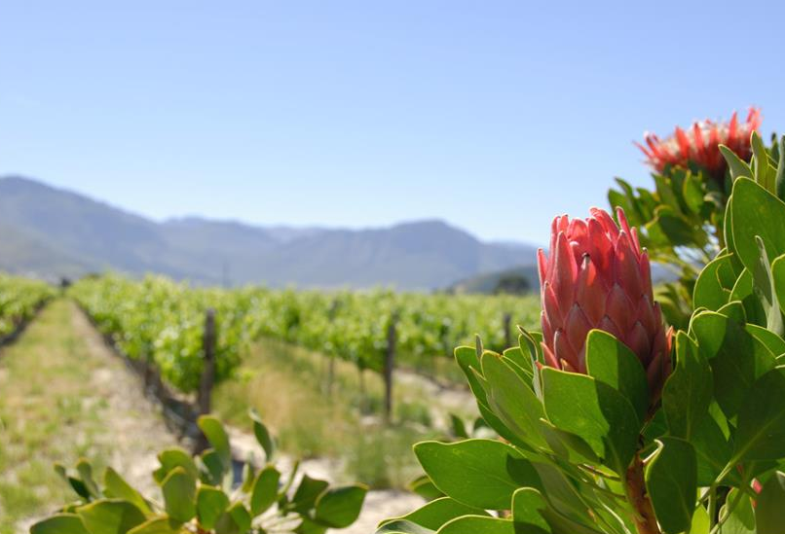
A treasure trove of winemaking possibilities
Notes:
The same array of unique soils and climates that created such a mind-boggling diversity of flora obviously also influences our vineyards and therefore our wines. Diversity of soils, matched by diversity of climate and geography, create a treasure trove of winemaking possibilities.

Slide 33

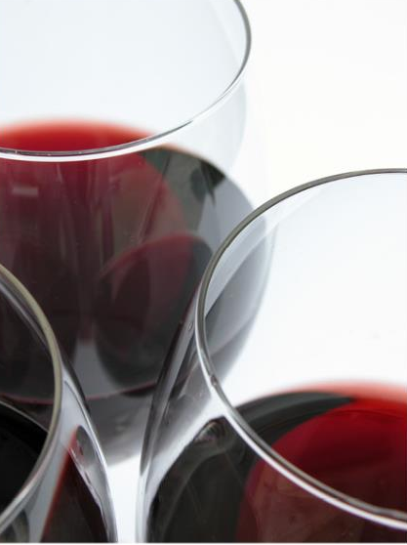
Cabernet Franc
Cabernet Sauvignon
Carignan
Cinsaut
Gamay
Grenache
Malbec
Merlot
Mourvèdre
Muscadel
Nebbiolo
Petit Verdot
Pinot Noir
Pinotage
Ruby Cabernet
Shiraz
Tinta Barocca
Touriga Nacional
Red-wine varieties
Notes:
A huge variety of red-wine varieties are planted. The most widely planted are Cabernet Sauvignon and Shiraz (Syrah).

Slide 34
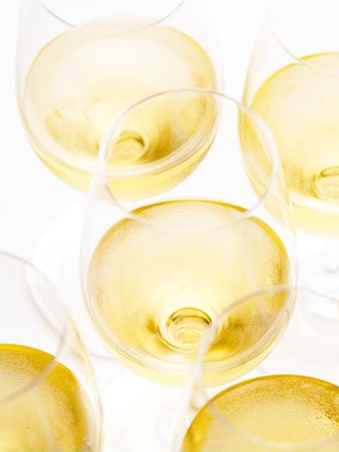
Bukettraube
Crouchen Blanc
Chardonnay
Chenin Blanc
Colombar
Riesling
Gewürztraminer
Grenache
Muscat d'Alexandrie
Muscadel
Nouvelle
Palomino
Pinot Gris
Sauvignon Blanc
Semillon
Trebbiano
Viognier
White-wine varieties
Notes:
A large variety of white-wine varieties are also planted. The most important are Chenin Blanc, Sauvignon Blanc and Chardonnay.

Slide 35
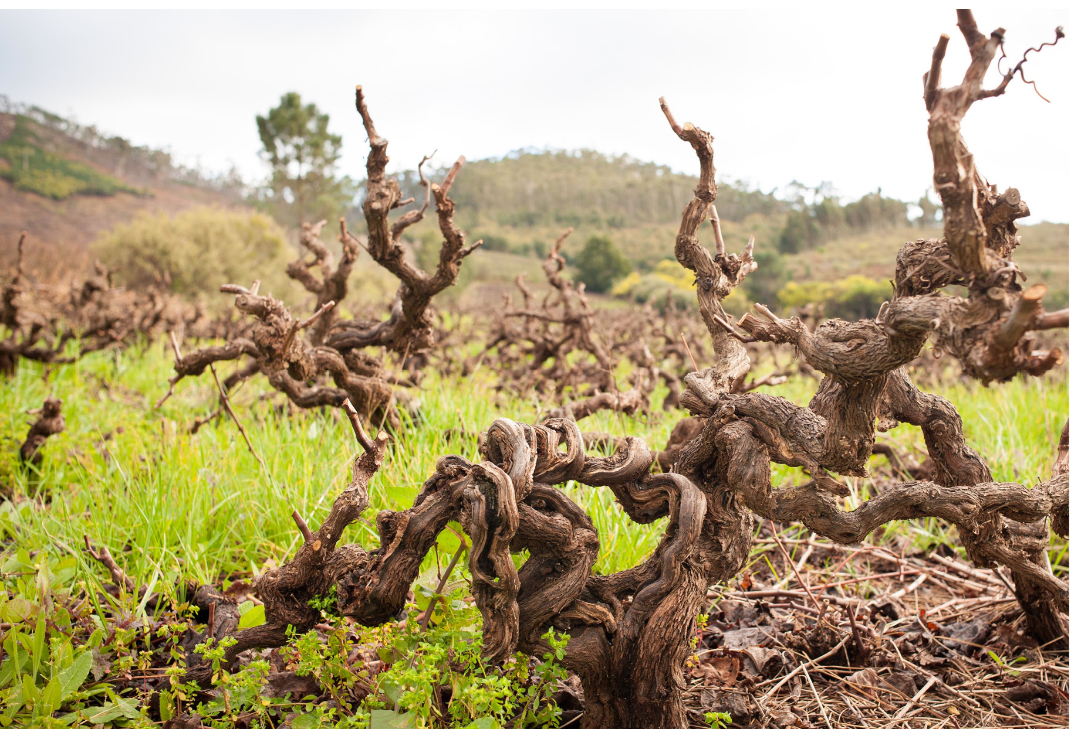
South Africa has the most Chenin Blanc plantings
in the world – 15 949 ha in 2025
Notes:
South Africa has the most Chenin Blanc plantings in the world – 15 949 ha in 2025.

Slide 36
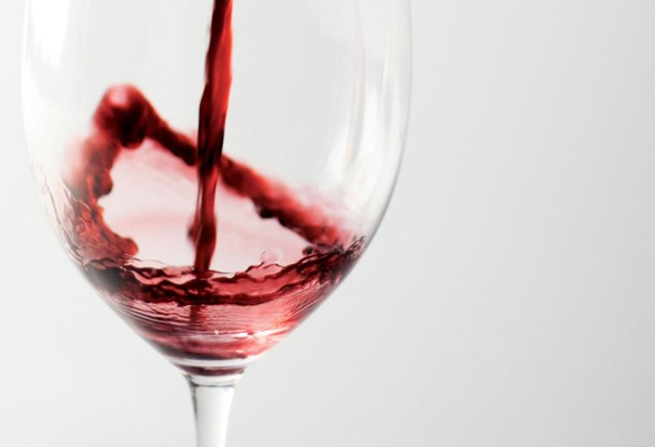
Pinotage is unique to South Africa
Notes:
The Pinotage grape variety is unique to South Africa. It was developed in 1925 by Prof Perold at the University of Stellenbosch, and is a cross between Pinot Noir and Hermitage (Cinsaut). Pinotage wine was first released commercially in 1961.

Slide 37
 | 1992 | 2025
Hectares | 82 844 | 86 525
% white varieties | 82 | 56
% red varieties | 18 | 44
Restructuring our vineyards
Notes:
The structure of South Africa’s vineyards has changed over the past three decades to be more in line with the international market demand.

Slide 38
“There are no stereotypes
in South African wine.
Each wine is full of life
– distinctive and exciting. ”
Notes:
There are no stereotypes in South African wine. Each wine is full of life – distinctive and exciting.

Slide 39
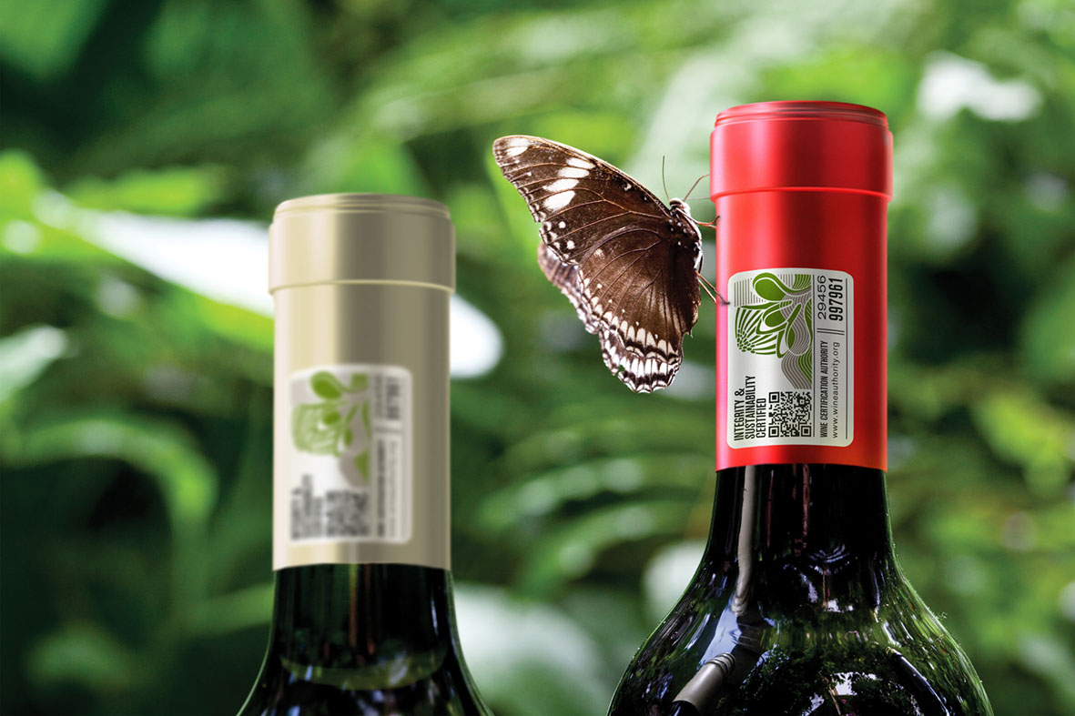
Certification seal
Notes:
Production integrity: Section 3

Slide 40
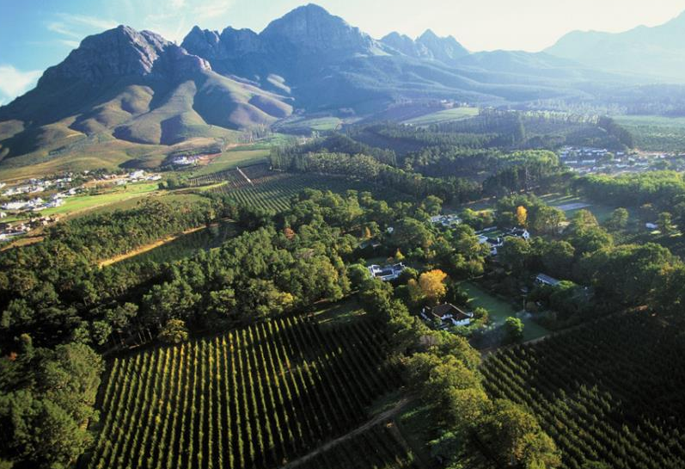
Wines of Origin
Regions, Districts, Wards, Estates and Single Vineyards
Notes:
The South African Wine and Spirit Board, appointed by the Minister of Agriculture, administers wine production under the extremely rigorous Wine of Origin certification scheme. The Wine and Spirit Board demarcates areas of origin, and the borders are defined by law. For a wine to claim an origin, 100% of the grapes must come from that area. The demarcated areas drill down from regions, to districts, wards and even specific vineyards.

Slide 41
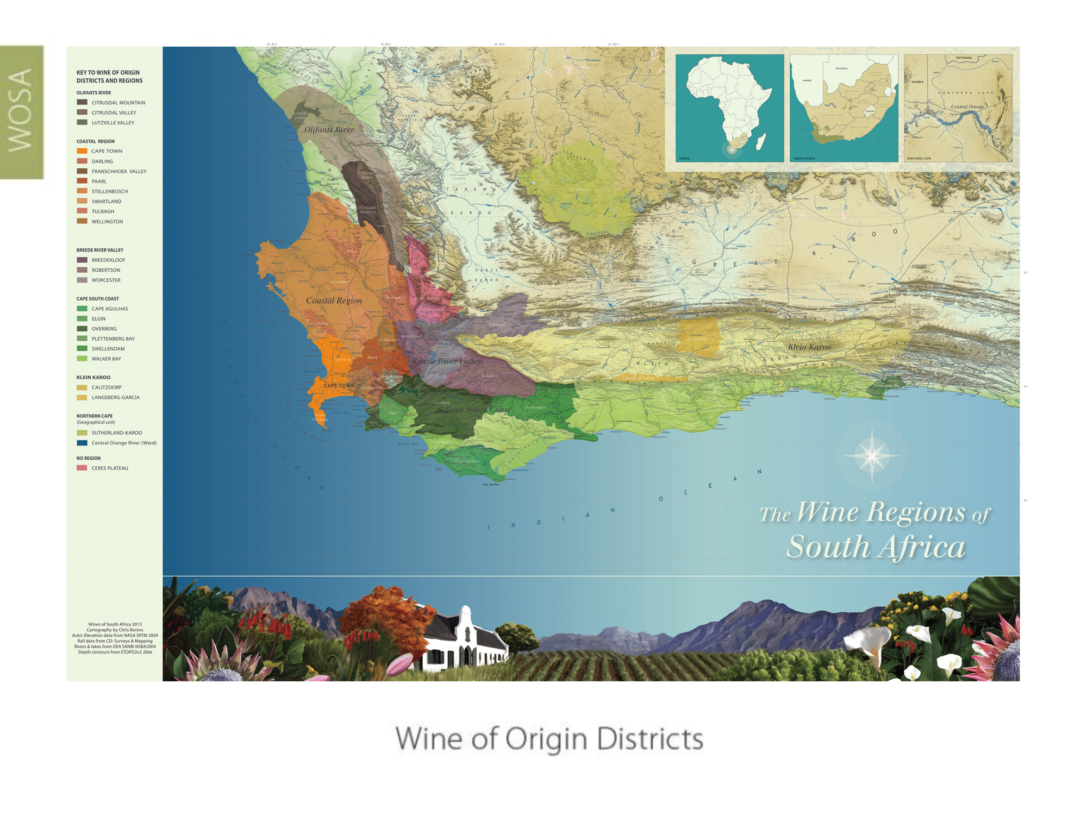
Wine of Origin Districts
Notes:
With the exception of the vineyards along the Orange River and a few hectares in KwaZulu-Natal, all the South African vineyards are in the Western Cape, relatively close to Cape Town.

Slide 42
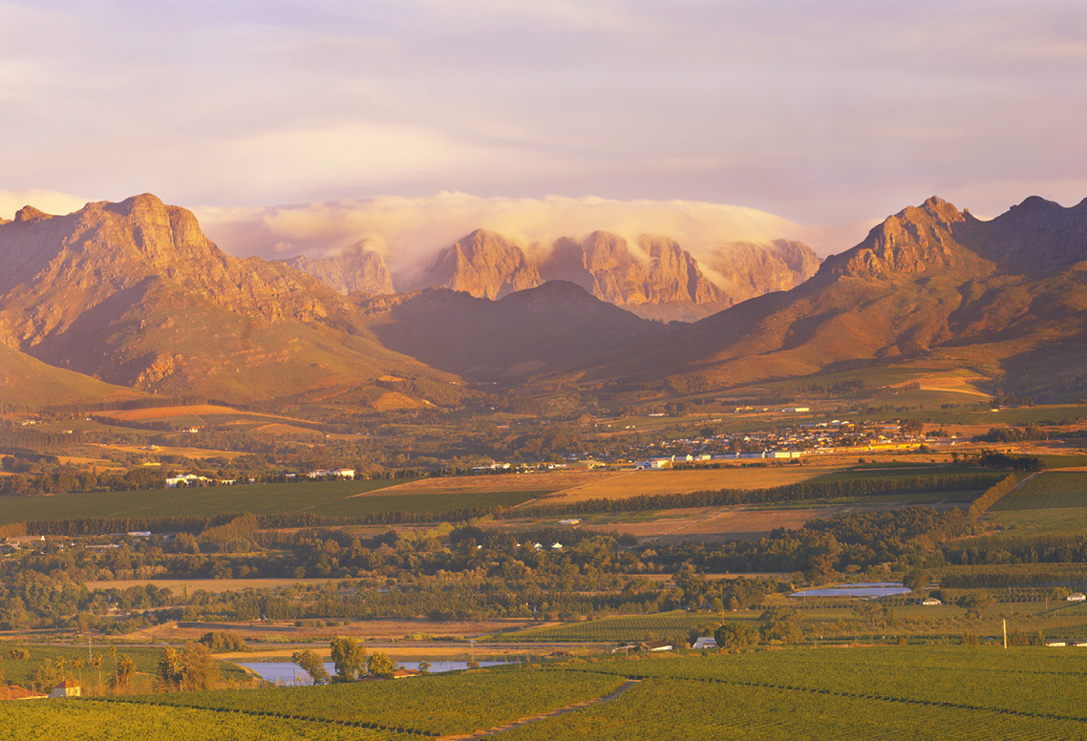
Established
Franschhoek Valley, Paarl, Stellenbosch,
Constantia and Durbanville
Notes:
The most established winegrowing areas are the districts of Franschhoek Valley, Paarl and Stellenbosch, and the wards of Constantia, our oldest winegrowing area, and Durbanville.

Slide 43
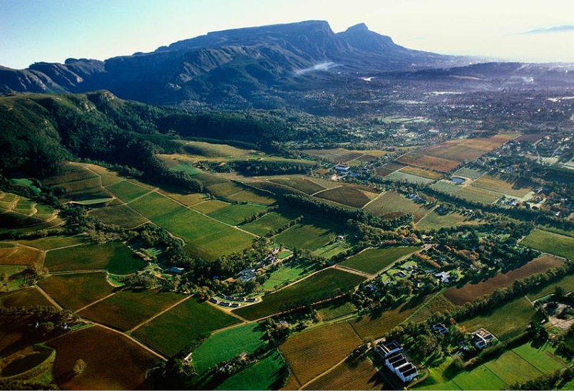
Constantia
Notes:
Constantia lies on the slopes of the Constantiaberg, a southern extension of Table Mountain, and is only 20 minutes away from Cape Town.

Slide 44
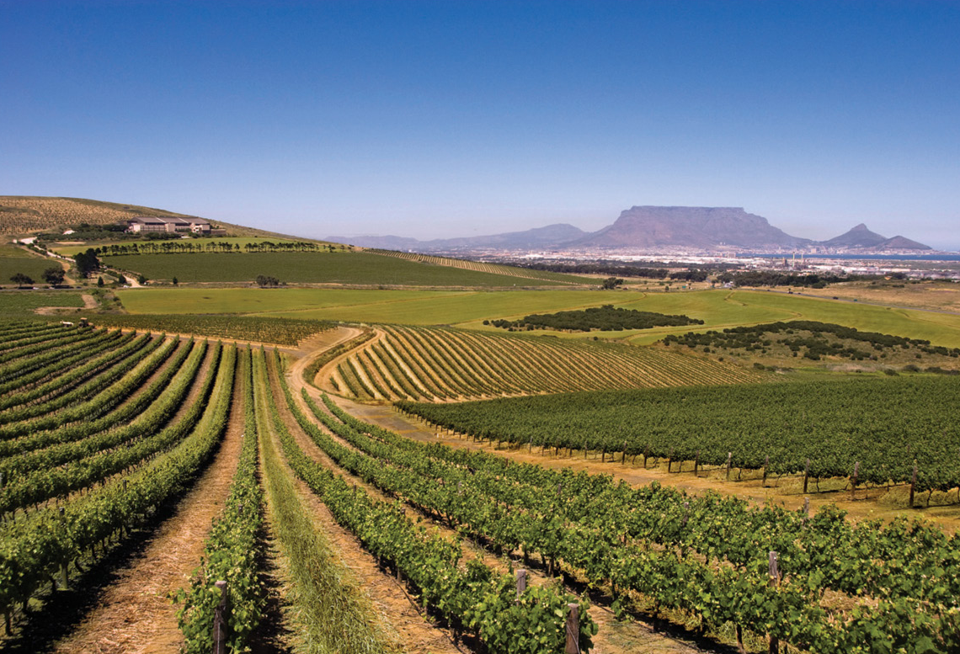
Durbanville
Notes:
Durbanville borders on Cape Town’s northern suburb and is characterised by a range of hills known as Tygerberg, from which the district this ward falls within takes its name.

Slide 45
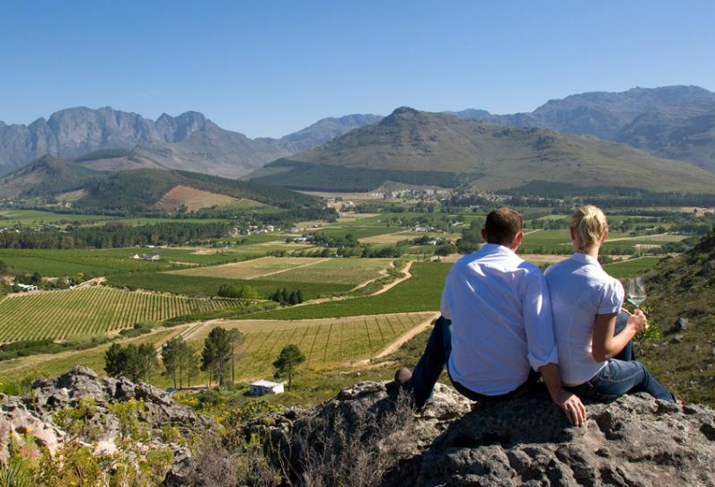
Franschhoek Valley
Notes:
The Franschhoek Valley district is enclosed on three sides by towering mountains and has retained its French charm as a romantic tourism destination.

Slide 46
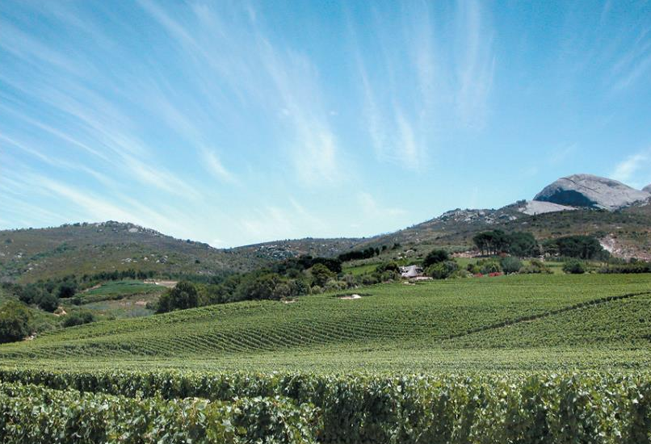
Paarl
Notes:
Paarl is situated beneath a large granite outcrop, the second largest in the world, the biggest being Uluru (previously Ayers Rock) in Australia.

Slide 47
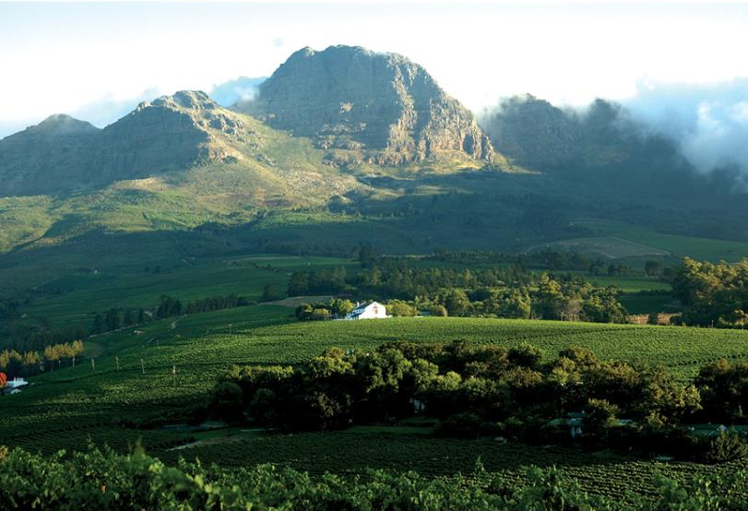
Stellenbosch
Notes:
Stellenbosch is a university town and the centre of the wine trade.

Slide 48
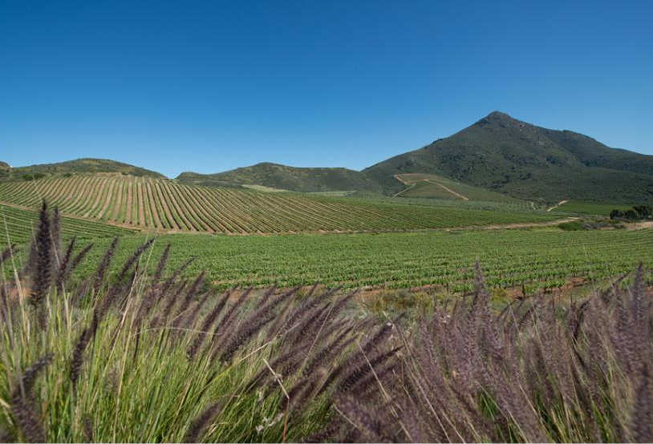
Rediscover
Robertson, Swartland, Tulbagh, Wellington
Notes:
Older areas that are being rediscovered are Robertson, Swartland, Tulbagh and Wellington.

Slide 49
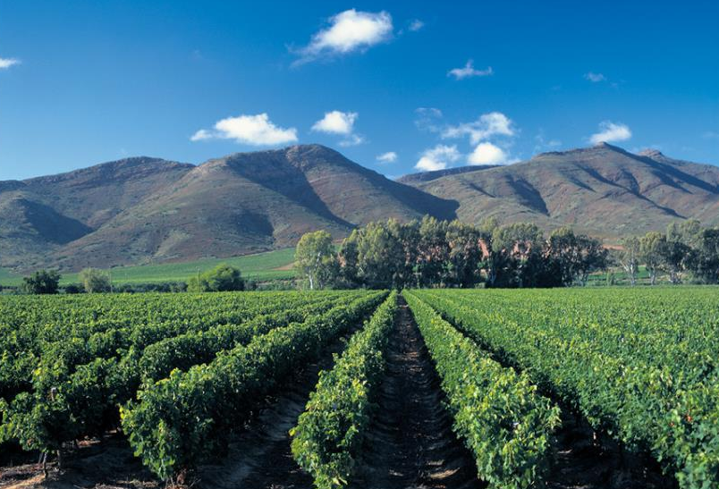
Robertson
Notes:
The Robertson district runs along the Breede River and is characterised by extreme differences in day and night temperatures.

Slide 50
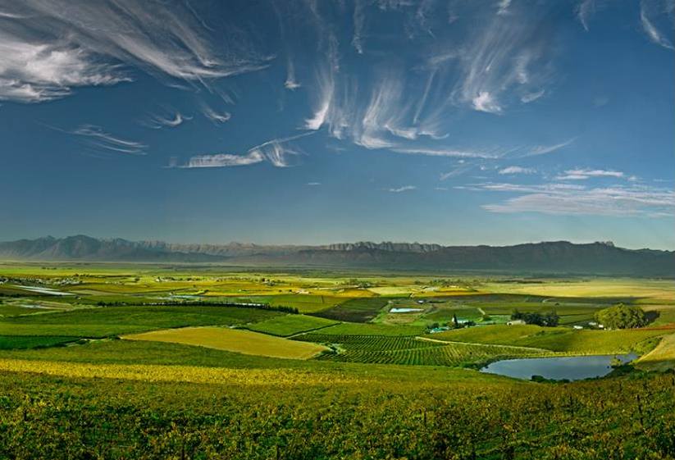
Swartland
Notes:
Traditionally a grain-producing area, the Swartland district is interspersed with older bush vines. A group of winemakers are driving an exciting renaissance here.

Slide 51
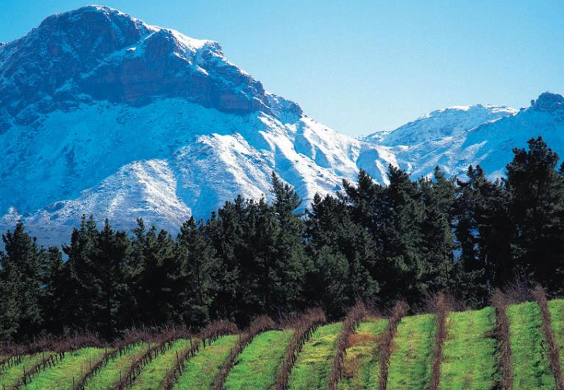
Tulbagh
Notes:
The Tulbagh district is a secluded valley characterised by a unique ‘cold trap’ – a cloud layer that keeps cool night air in the valley until quite late into the morning.

Slide 52
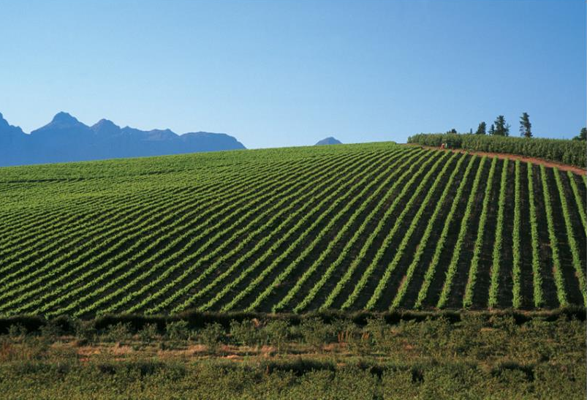
Wellington
Notes:
Wellington, which has recently been demarcated a district, is where most of the vineyard nurseries are located.

Slide 53
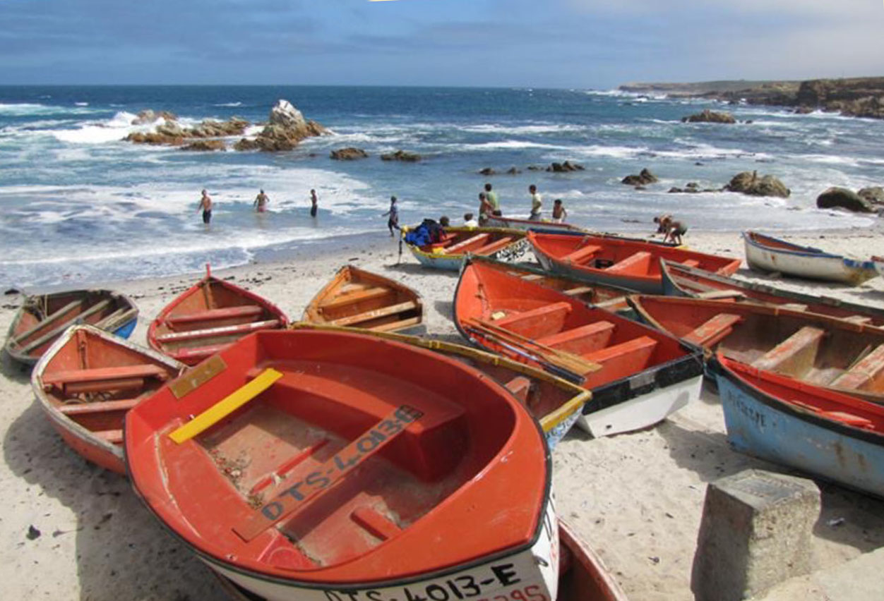
Explore
Darling and Olifants River
Notes:
Explore winegrowing areas along the West Coast, which are influenced by the cold Benguela current.

Slide 54
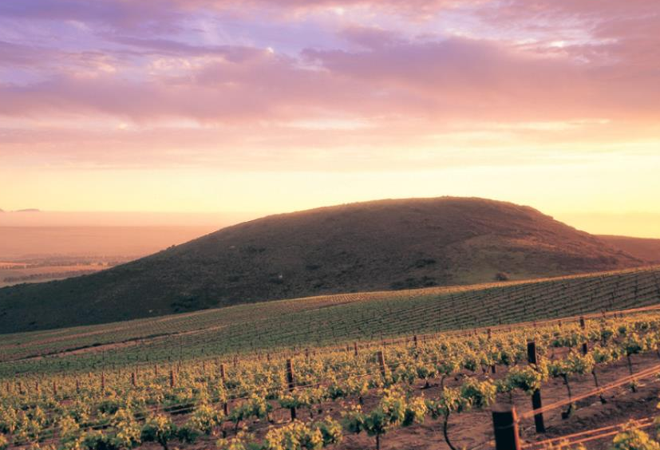
Darling
Notes:
The Darling district comprises a range of hills running parallel to the Atlantic Ocean.

Slide 55

Olifants River
Notes:
In the Olifants River region newer wards such as Bamboes Bay, as well as stand-alone wards like Cederberg and Lamberts Bay, are producing exciting wines.

Slide 56

New and exciting areas
Bot River, Elgin, Elim and Hemel-en-Aarde
Notes:
New and exciting areas that have emerged in the Cape South Coast region in the past decade are Bot River, Elgin, Elim and Hemel-en-Aarde.

Slide 57

Bot River
Notes:
The Bot River ward is renowned for its cool maritime microclimate, which is influenced by its proximity to the lagoon and Walker Bay.

Slide 58

Elgin
Notes:
The cool Elgin district was originally an apple-growing region and is increasingly maximising on these climatic features to produce cool-climate wines.

Slide 59

Elim
Notes:
The Elim ward is the southernmost of the maritime vineyards – it’s exposed to very strong south-easterly winds.

Slide 60

Hemel-en-Aarde Valley
Notes:
Hemel-en-Aarde comprises three distinct wards. Hemel-en-Aarde Valley, Hemel-en-Aarde Ridge and Upper Hemel-en-Aarde Valley.

Slide 61

Klein Karoo
– fortified & Portuguese varietal table wines
Notes:
The elongated semi-arid Klein Karoo region is well known for its port-style wines.

Slide 62

Breedekloof – a traditionally high-yielding region
with a recent trend towards smaller batches
Notes:
High-yielding areas include Breedekloof, Central Orange River and Worcester.

Slide 63

Breedekloof
Notes:
The vineyards of the Breedekloof area flourish on the alluvial valley soils.

Slide 64

Central Orange River
Notes:
Central Orange River alongside the Orange River is the most northerly winegrowing area in South Africa.

Slide 65

Worcester
Notes:
Worcester’s winelands are traditionally planted in the fertile flood plains of the Breede River.

Slide 66

≠hannuwa
Notes:
The /Xam San were the world’s first environmentalists. Their legacy lives on in the commitment of South Africa wine producers to farm sustainably and conserve their land for future generations. This philosophy is embodied in the San word ≠hannuwa, which means ‘the gathering of good fortune through living in harmony with nature’.

Slide 67

Sustainable winegrowing practices
Notes:
Sustainable Wine South Africa is administered by the Wine and Spirit Board, and drives the sustainable farming initiative, the Integrated Production of Wine (IPW). It employs independent auditors to check the IPW status of winegrowers. IPW is a scheme that specifies environmentally sustainable practices, rules and regulations. This scheme was introduced to the industry in 1998. Guidelines cover environmental impact care, monitor water usage, health and safety, and protect and conserve our unique natural habitat.

Slide 68


Sustainability seal
Notes:
From 2010, producers who are certified as sustainable by Sustainable Wine South Africa have been be able to use the new Wine and Spirit Board certification seal that highlights this commitment to environmentally sustainable wine production. Consumers can trace every bottle back to the vineyard practices of its source, and know that the wine has been sustainably produced and audited as such.

Slide 69

Vintage
Variety
Origin
Notes:
For a producer to make a claim on a wine label, 85% of the wine must come from that vintage, 85% of the wine must come from that variety and 100% of the wine must come from that area.

Slide 70
Certification seal
Notes:
The certification seal on the bottle is an absolute guarantee to the consumer that the claims on the packaging regarding vintage, variety and origin are true, and the wine was of good quality when evaluated by the Wine and Spirit Board for certification.

Slide 71

Respect for people and the environment
Notes:
The South African wine industry is concerned with the triple bottom line: profit, people and the environment.

Slide 72

Wine Industry Ethical Trade Initiative (WIETA)
Notes:
South Africa is unique in that our wine industry has established the Wine Industry Ethical Trade Initiative (WIETA), an independent, not-for-profit, multi-shareholder organisation established in 2002. Committed to ethical trading, and improving and safeguarding the working conditions of employees in agriculture.

Slide 73

Ethical seal
Notes:
In 2012, WIETA introduced a new ethical seal that testifies to reasonable working conditions, based on rigorous and closely monitored qualification criteria. This is believed to be a world first among wine-producing countries.

Slide 74

Pebbles – pre-primary farm project
Notes:
Producers are keen to help a new generation of farm children access educational opportunities that were denied their parents. This is a toy library run by the Pebbles Project, one of the many NGOs operating on the farms.

Slide 75

Fairtrade wines
– more than 80% sold worldwide from South Africa
Notes:
South Africa has more Fairtrade wines than any other country. In 2025, more than 80% of all Fairtrade wines sold in the world originated in South Africa.

Slide 76

Black-owned brands
Notes:
Black-owned brands are gaining traction as the wine industry becomes more representative of the general population.

Slide 77
“South African wines lead
the world in production
integrity and
environmental sustainability. ”
Notes:
South African wines lead the world in production integrity and environmental sustainability.

Slide 78

Wamkelekile – the warmest welcome
Notes:
‘Wamkelekile’ means ‘The warmest welcome’ in isiXhosa: Section 4

Slide 79

Our wines are as diverse as our people –
we make up a cultural and ethnic rainbow
Notes:
Modern South Africans are descended from many origins and the country has 11 official languages.

Slide 80


Extraordinary people
Notes:
There are extraordinary people in South Africa’s past and present, for example iconic leader Nelson Mandela.

Slide 81

Nobel laureates – Peace Prize winners
Notes:
Four South Africans have won the Nobel Peace Prize: Albert Luthuli (1960), Desmond Tutu (1984), Nelson Mandela (1993) and FW de Klerk (1993).

Slide 82

Ubuntu
Notes:
Ubuntu is a unique South African philosophy which is about the essence of humanity. You can’t exist as a human in isolation, we are all interconnected.

Slide 83

Cape cuisine
Notes:
South Africa’s diverse cultural heritage is reflected in Cape cuisine, which marries all the influences of our origins with wonderful produce.

Slide 84

Braai (barbeque)
Notes:
South Africans are passionate about cooking meat on the barbeque, which they call a braai.

Slide 85


Wine Tourism – www.greatwinecapitals.com

Slide 86

Wild game
Notes:
Wild buck are still found in the mountains and countryside – many farmers keep small herds.

Slide 87

Image courtesy of The Cape Leopard Trust
The Cape Leopard Trust
Notes:
The Cape Leopard Trust, which facilitates conservation of the Cape’s predator diversity through implementing conservation strategies, research projects and tourism initiatives, was launched in 2004 and has achieved remarkable success.

Slide 88

V&A Waterfont
Notes:
At the Victoria and Albert Waterfront, tourists from all over the world enjoy our memorable cuisine and wines, all with a stunning view of majestic Table Mountain.

Slide 89

Fine restaurants at wineries
Notes:
There are many fine restaurants at wineries within easy driving distance of Cape Town.

Slide 90

Camps Bay
Notes:
There are wonderful beaches all around the Cape.

Slide 91

Boulders Beach
Notes:
All very different and spectacular.

Slide 92
“South African wines are
wines to enjoy because we
understand that life is good.”
Notes:
South African wines are wines to enjoy because we understand that life is good.

Slide 93

Statistics
Notes:
A quick look at the statistics and figures: Section 5

Slide 94

South Africa ranks as seventh when it comes to total world production and produces 4.5% of the world’s wine (2025)
Notes:
In terms of world wine production, South Africa ranks as number seventh in overall volume production of wine and produces 4.5% of the world's wine (2026).

Slide 95



HECTARES
Source: SAWIS
Area under wine grape vineyards
(excluding Sultana)
Notes:
Total ha under wine grapes: From 99 597 ha in 2015 to 86 525 ha in 2025.

Slide 96


HECTARES
Source: SAWIS
Wine grape vineyards planted and uprooted
(excluding Sultana)
Notes:
Although total plantings have not increased significantly, there has been a dramatic restructuring of the South African vineyards with substantial uprooting and replanting in the past two decades.

Slide 97
Variety | 2025
Chenin Blanc | 18.4%
Sauvignon Blanc | 12.1%
Colombar(d) | 10.6%
Chardonnay | 7.6%
Total white-wine varieties | 56%
Cabernet Sauvignon | 9.9%
Shiraz | 9.4%
Pinotage | 7.6%
Merlot | 5.7%
Total red-wine varietes | 44%
Source: SAWIS
Wine grapes as % of total vineyard area
Notes:
In 1990, 84% of the vineyards were planted to white-wine varieties. In 2025, the figure was 56%.

Slide 98

Source: SAWIS
Age of vines per wine region for 2025 – hectares
(Excluding Sultana)
Notes:
28.7% of South Africa’s total vineyards are under 10 years old. In the case of red-wine varieties the figure is 12.0% of total red and, in white-wine varieties, 16.7% of total white.

Slide 99

Exports in Litres
Notes:
Since the advent of democracy South Africa has achieved notable success in exports, with volumes increasing from 22 million litres in 1992 to 264 million litres in 2025.

Slide 100

Africa
Canada
China
Germany
Hong Kong
Japan
Sweden
The Netherlands
UK
USA
Countries
www.wosa.co.za
Notes:
The UK is South Africa’s number one export destination, followed by European countries such as The Netherlands and Sweden. Canada, the USA, China and African countries are increasingly important destinations.

Slide 101

Accolades
IWSC | Robert Parker | Wine Spectator | IWC | Decanter
Notes:
South African wines are constantly improving, a fact reflected in the increasing number of international accolades.

Slide 102

Why are our wines so special?
Notes:
Why are South African wines so special?

Slide 103

You can taste the life in our wines
Notes:
You can taste the life in South African wines because, where our vines grow, there is more diverse life per square metre than anywhere else on the planet.

Slide 104

You can taste the purity and intensity
Notes:
There is a purity and intensity in our wine flavours that comes from growing our wines in harmony with our environment and its over 10 000 other plant species.

Slide 105

“We are all South Africans.”
Notes:
All human beings can trace their ultimate heritage to South Africa – maybe that’s why South African wines taste of ‘home’.

Slide 106

Thank you
Notes:
Thank you

Slide 107

The end
Notes:
The end

